Slide 1
Project Final Report
Team E: Jiayu Yao, Shang Liu, Yuqiao Han
Notes:
Hello

Slide 2
Goals
(1) Find important attributes that are powerfully influencing a video’s number of views.
(2) Give specific guidance on how to construct the video’s title, tags, descriptions, publishing time period in a day, etc., in order to have a higher number of views.
Data Description
The data comes from the Kaggle dataset. It is the trending YouTube Video Statistics collected using YouTube API, which is a record of several months of daily top trending videos on YouTube (US region). The size of the dataset is 40,000, containing 16 attributes including both numerical and categorical features. Sample numerical features are views counts, likes counts, dislikes counts, publish time, comment counts. Sample categorical features are video title, category, channel title, tag words, video descriptions, thumbnails.
Data example:
Video_id: 2kyS6SvSYSE, Trending_date: 17.14.11, Title: WE WANT TO TALK ABOUT OUR MARRIAGE, Channel_title: CaseyNeistat, Category_id: category_id, Publish_time: publish_time, Tags: Shantell Martin, Views: 748374, Likes: 57527, Dislikes: 2966, Comment_count: 15954, Comments_disabled: False, Ratings_disabled: False, Video_error_or_removed: False
Team E: Jiayu Yao, Shang Liu, Yuqiao Han

Slide 3
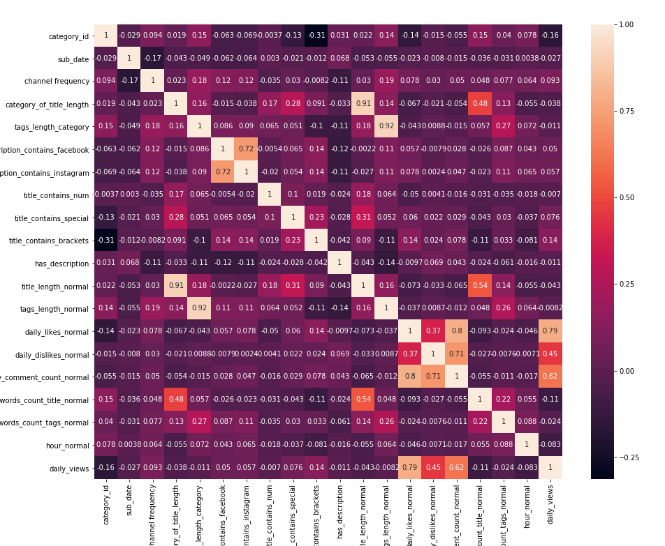
Feature Engineer
1) Channel Frequency
2) Publish Hour
3) Video Category
4) Tag Words Length
5) Title Length
6) Number of Stop Words in Title
7) Number of Stop Words in Tag
8) Brackets in Title
9) Numbers in Title
10) Special Characters in Title
11) Contains Facebook Links in Descriptions
12) Contains Instagram Links in Descriptions
13) Category of title length
14) Category of tags length
Heat Map
Team E: Jiayu Yao, Shang Liu, Yuqiao Han
Notes:
Normalize the features

Slide 4
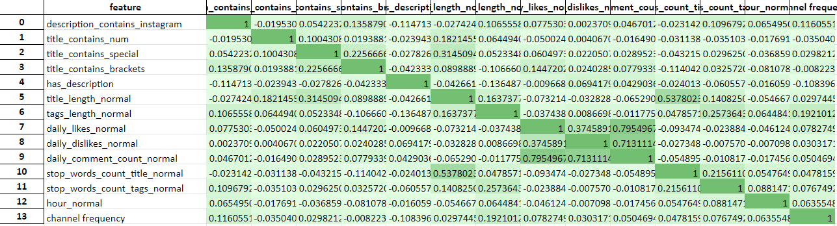
Pearson Correlation Coefficient Analysis
Team E: Jiayu Yao, Shang Liu, Yuqiao Han
Notes:
Pearson, high correlation between the title length and stop words so only choose title length

Slide 5
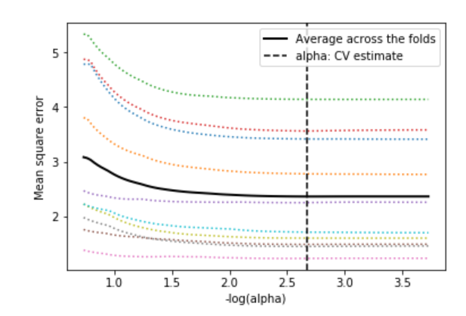
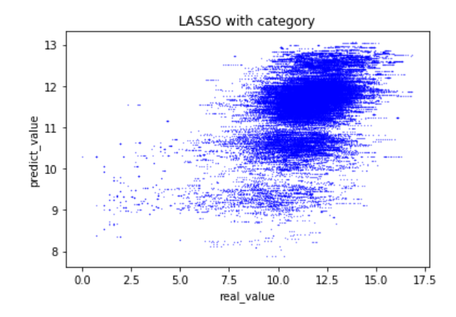
Linear Regression
Team E: Jiayu Yao, Shang Liu, Yuqiao Han
Notes:
Log y
MSE 2.46
R square 0.235
The plot on the left is the change of Mean Square Error when we change alpha.
The right plot is not showing a straight line, shows that the performance is not that good.

Slide 6
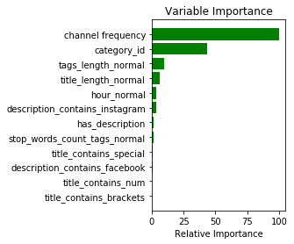
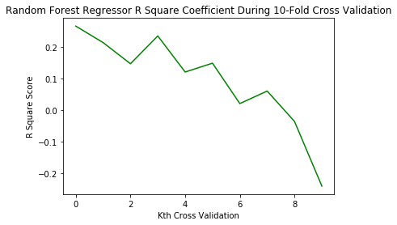
Random Forest
Team E: Jiayu Yao, Shang Liu, Yuqiao Han

Slide 7
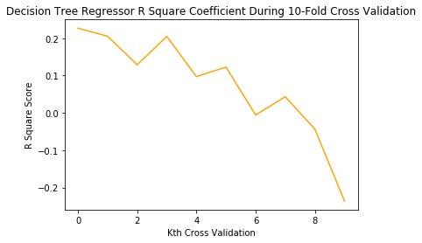
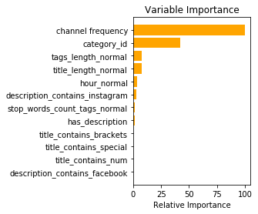
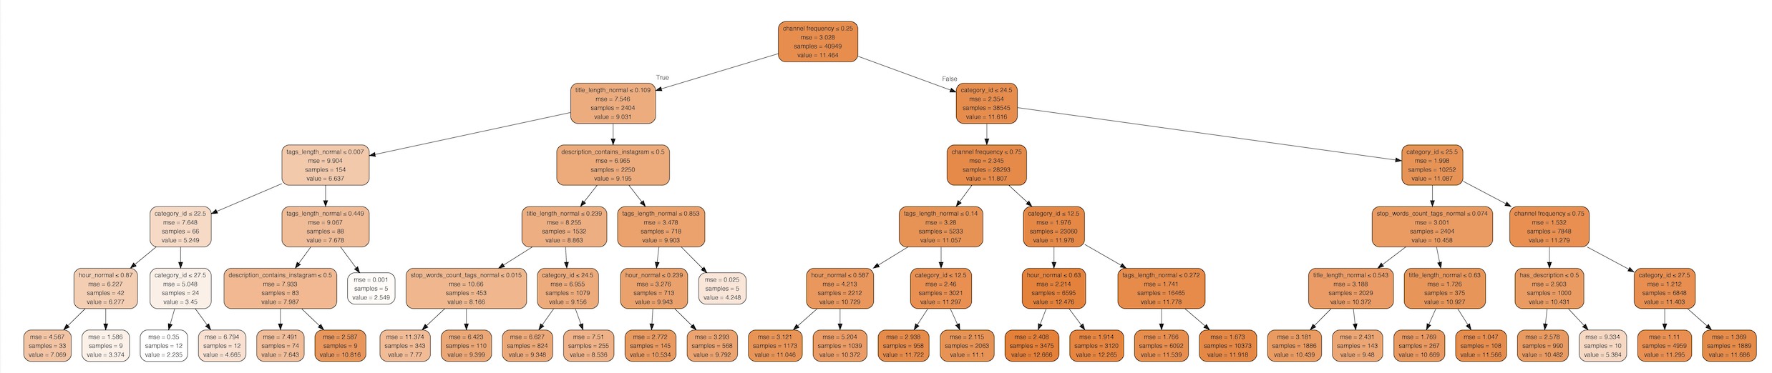
Decision Tree
Team E: Jiayu Yao, Shang Liu, Yuqiao Han

Slide 8
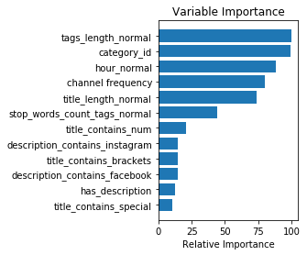
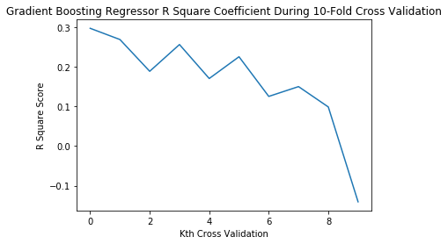
Gradient Boosting Regressor
Team E: Jiayu Yao, Shang Liu, Yuqiao Han

Slide 9
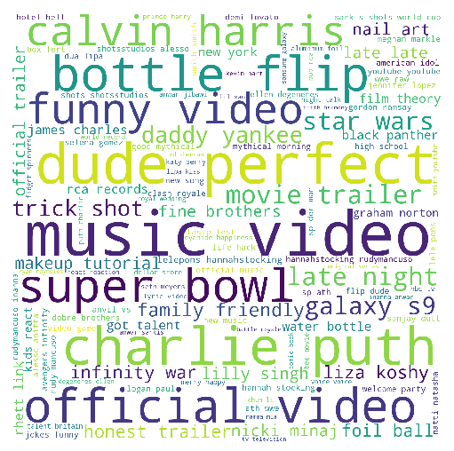
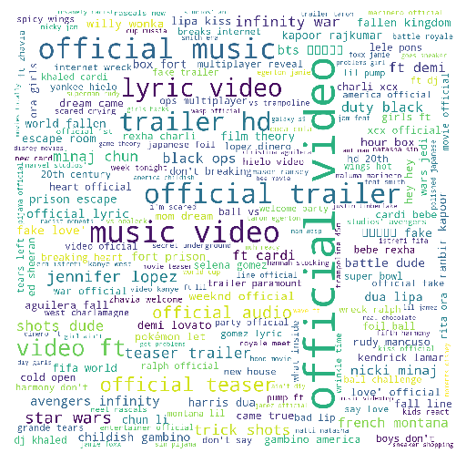
Word Cloud
Tags used in highly viewed videos
Title words used in highly viewed videos
Team E: Jiayu Yao, Shang Liu, Yuqiao Han

Slide 10
Conclusion
TOP Features
channel frequency
ideo category
title length
tag length
publish hour
Suggestion for Stakeholders
Publish as many as possible videos to arise your channel frequency.
Post in the morning, more specifically earlier than 2PM.
Use less than 2 stop words in tags.
Use less than 10 tags.
Use “official video” as tags if possible.
Categories of 'Film and Animation', 'Music', 'Gaming’, 'People and Blogs', 'Comedy' and 'Entertainment’ usually get more views, try to post videos in these topics!
Team E: Jiayu Yao, Shang Liu, Yuqiao Han

Slide 11
Risk
The conclusion is drawn by only 40000 samples which not enough.
Some of the features such as “category ID” is not complete (only include 16 categories).
The data of the video is the “trending video” which is a special part of all of the videos in youtube.
Even though we only need the importance of the features instead of the prediction, the prediction results of the model is not so good which may cause less cogency.
Find more features such as the sequence of words in the description, the attribute of cover pictures to make the model more accuracy and make the further analysis.
Get more data of the youtube video from internet.
Further Work
Team E: Jiayu Yao, Shang Liu, Yuqiao Han

